Slide 1
Teaching Introduction to Programming Using Python

Slide 2
Objectives
Provide some understanding of programming to non-programmers
Present operations and methods used by programmers
Enable and energize new programmers

Slide 3
Programming is Telling the Computer What You Want done
The programing language, PYTHON, contains the rules
Python is popular, powerful, and EASY
Like most human languages, you don’t have to know all to get things done

Slide 4
Computer = VERY Obedient Servant
Car Example
Most cars are alike
Does exactly what you tell it – hopefully what you want
Same response every time – almost – e.g. forward / backward
Car gets the blame…

Slide 5
Similar activities
Abstract / Indirect
Cooking recipes
Travel directions
Assembly instructions
Physical – What you see is what you get
Construction - Roads, Buildings

Slide 6
Like Computer Programming
Build once – use many times
Builder and user(s) often different
Building errors show up many times
Building errors don't always show up immediately

Slide 7
Not so like Computer Programming
Physical materials
Hard to copy
Hard to manipulate
Easy to see

Slide 8
What's Easy – Because No so physical
Creation / copying / moving is a snap
Things don't wear out – works today, tomorrow, forever
Easy to change
Working on new one, while the old one is running

Slide 9
What's Not Easy – because No so physical
Can't "see" it
Everything is connected – unexpected consequences
Often not easy to tell how close to done

Slide 10
Learning Environment – python’s IDLE
https://www.python.org
Download latest python 3.7.0
Python shell
Documentation
IDE - editor, execution, debugger

Slide 11
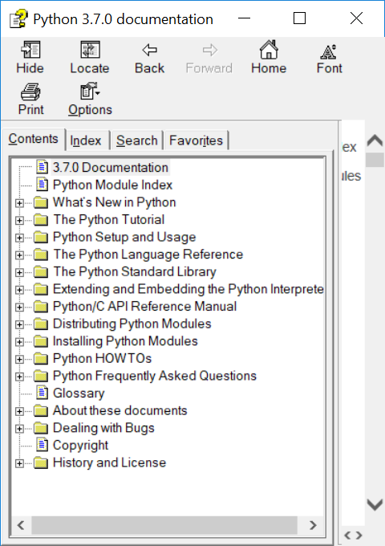
IDLE – Lots of Nice STUFF

Slide 12
A Program We Can do
I’m thinking of a number …
Simplification sometimes helps the user
Accept number and tell if greater, less, equal
Iteration allows us to learn and test along the way

Slide 13
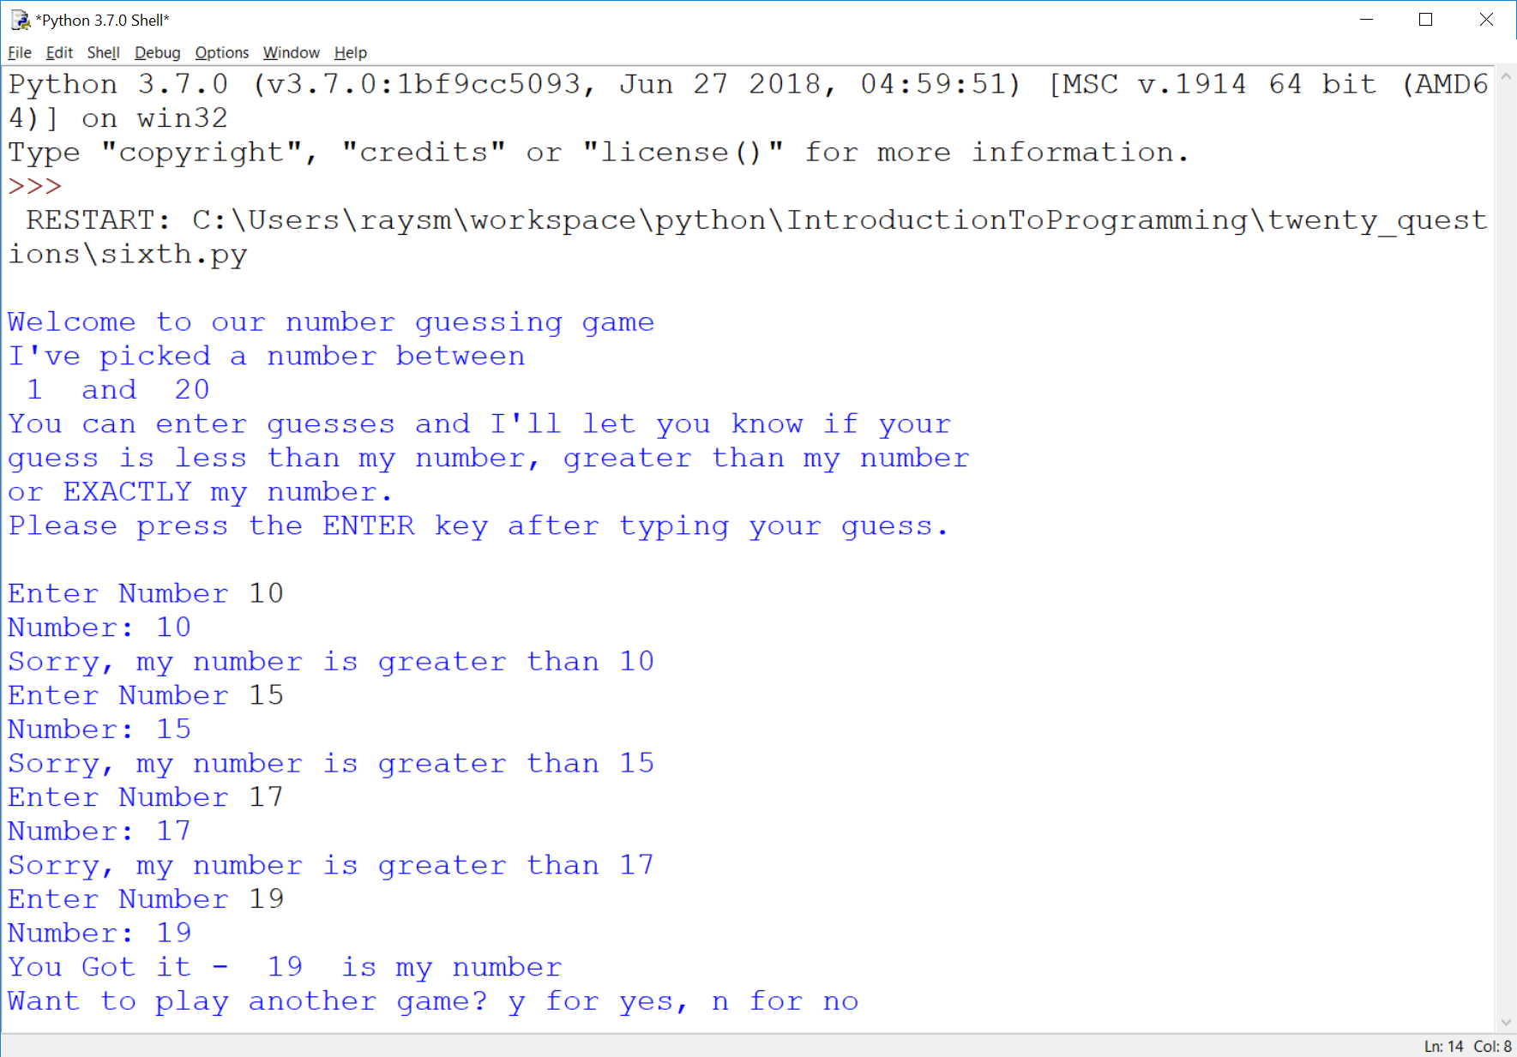
Working Program

Slide 14
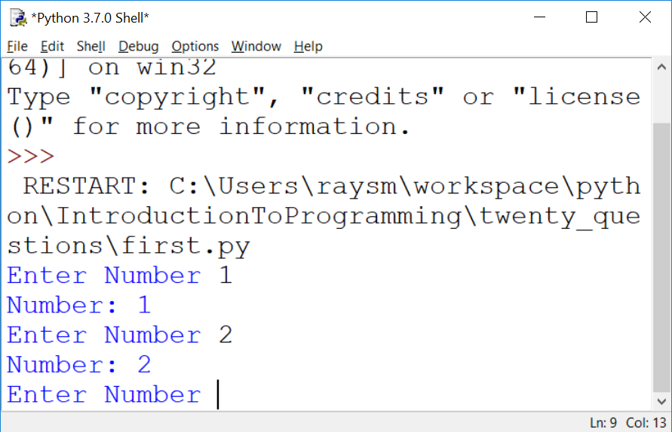
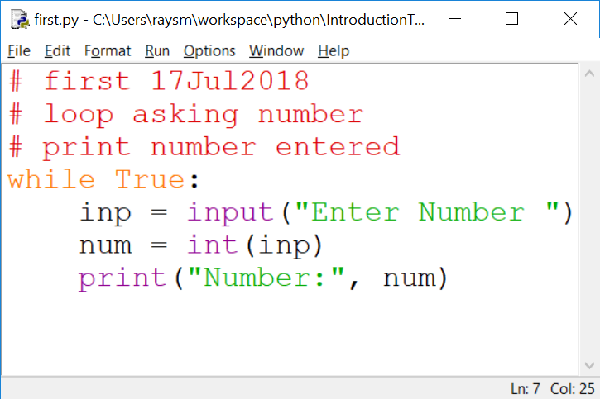
The First Iteration

Slide 15
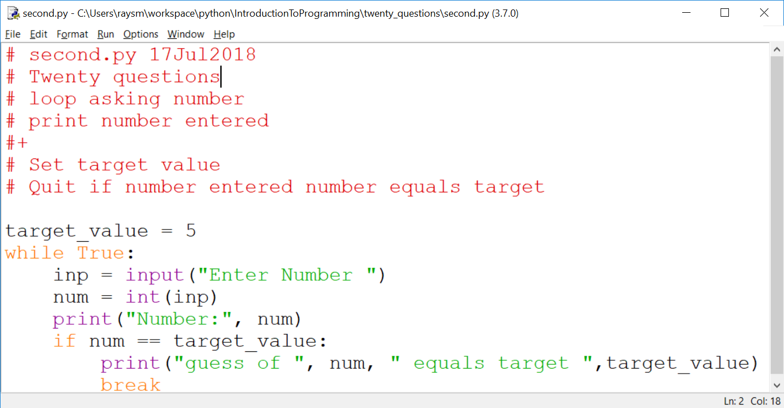
Second Iteration – Just a bit More

